Slide 1
Lecture 11 – Exhaustive Search
CST370 – Design & Analysis of Algorithms
Dr. Byun
Computer Science

Slide 2
Lecture Objectives
After completion of this lecture, you will be able to
  apply exhaustive search to solve combinatorial problems such as TSP, knapsack, and job assignment problems.

Slide 3
Chapter 3: Brute Force and Exhaustive Search
3.1 Selection Sort and Bubble Sort
3.2 Sequential Search and Brute-Force String Matching
3.3 Closest-Pair and Convex-Hull Problems by Brute Force
3.4 Exhaustive Search
3.5 Depth-First Search and Breadth-First Search

Slide 4
Exhaustive Search
Watch this video
  https://youtu.be/o_Bk8lE795Q
Exhaustive search is a brute-force approach to solve combinatorial problems such as TSP.
  Generate all potential solutions (or all possible cases) to the problem.
  Evaluate each case one by one.
  Determine the solution among the possible cases.

Slide 5
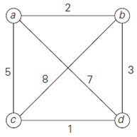
Traveling Salesman Problem (TSP)
TSP is to find the shortest tour through a given set of n cities that visits each city exactly once before returning to the city where it started.
  We introduced it in Chap. 1.3.
  https://youtu.be/67DMNFzzIpo
Example

Slide 6
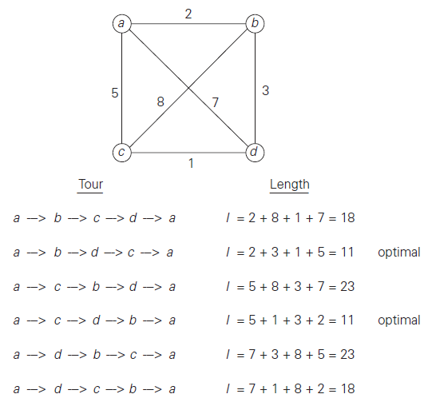
Exhaustive Search for TSP
To solve the problem, you must find all permutations of the nodes b, c, and d.

Slide 7
Time Complexity of TSP
  If there are n nodes in the question, we should identify all possible paths of the (n-1) node, except for the starting node.
  The total possible paths are
  (n-1)! = (n-1) * (n-2) * … * 2 *1
  Therefore, the time efficiency of the problem requires at least (n-1)!

Slide 8
Puzzle
There are three boxes with labels outside each box.
  Box 1: Gold is not here.
  Box 2: Gold is not here.
  Box 3: Gold is in the box 1.
One label is true and two labels are false.
  Where is gold?

Slide 9
Knapsack Problem
Watch this video first
  https://youtu.be/OC85aM7SFts
Given n items
  weights: w₁, w₂, . . . , w_{n}
  values: v₁, v₂, . . . , v_{n}
Find the most valuable subset of the items that fit into a knapsack with the capacity W.
Note that there is only one quantity per item.

Slide 10
Example
Knapsack capacity: 10 (i.e.: W = 10)
Item 1: w₁ = 7, v₁ = $42
Item 2: w₂ = 3, v₂ = $12
Item 3: w₃ = 4, v₃ = $40
Item 4: w₄ = 5, v₄ = $25

Slide 11
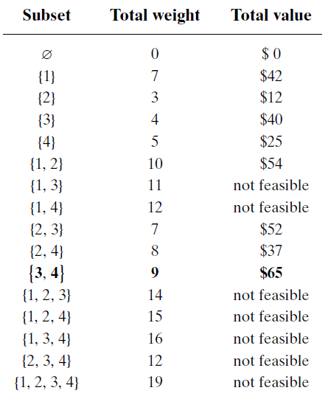
Knapsack Problem – Exhaustive Search
Basic Idea
Consider all possible subsets.
Compute the weight and value of each subset.
Find the best subset which provides the maximum value.

Slide 12
Time Efficiency of Knapsack Problem
Note that the number of possible subsets of a set with n items is 2^{n}.
  Thus, the exhaustive search algorithm requires at least (2^{n}) time complexity.
  For example, the solution to the question in our example has 16 (= 2⁴) subsets for a set of 4 items.

Slide 13
NP-Hard Problem
TSP and knapsack problem are the best-known examples of NP-hard problems.
For any NP-hard problem, no polynomial-time algorithm is known.
  Most computer scientists believe that such algorithms do not exist.
  But nobody has proved it yet.

Slide 14
Sample Code for Exhaustive Search
For the exhaustive search, you need to generate either permutations or subsets for an input data.
The following slides present a few sample C++ programs to generate permutations and subsets.

Slide 15
Generating All Permutations of a String
https://repl.it/@YBYUN/permutations
  Run the program and read the program to understand the operation of it.
  Change the string in the main() to a different one such as “A”, “AB”, or “ABCD” to make sure that the program works well in several different strings.

Slide 16
Generating All Permutations: Source Code
// In the main() function
permute(“ABC”, 0, 2); // 0: starting index, 2: ending index.
void permute(string a, int l, int r) {
if (l == r)
cout << a << endl;
else {
for (int i = l; i <= r; i++) {
swap(a[l], a[i]);
permute(a, l+1, r);
swap(a[l], a[i]);
}
}
}

Slide 17
Source Code Explanation
void permute(string a, int l, int r)
{
if (l == r)
cout << a << endl;
else
{
for (int i = l; i <= r; i++)
{
swap(a[l], a[i]);
permute(a, l+1, r);
swap(a[l], a[i]);
}
}
}

Slide 18
All Permutations of an Array using STL
You can also generate the permutations of an array using a STL function next_permutation().
  https://repl.it/@YBYUN/permutationsusingSTL

Slide 19
Generate All Subsets of a Set
https://repl.it/@YBYUN/powerset
  Run the program and read it carefully to understand the operation.

Slide 20
Generating All Subsets: Source Code
// In the main()
char set[ ] = {'a','b','c'};
print_subsets(set, 3);
void print_subsets(char *set, int set_size) {
unsigned int subset_size = pow(2, set_size);
for(int counter = 0; counter < subset_size; counter++) {
for(int j = 0; j < set_size; j++) {
if(counter & (1 << j))
cout << set[j] << ' ';
}
cout << endl;
}
}

Slide 21
Source Code Explanation
void print_subsets(char *set, int set_size)
{
unsigned int subset_size = pow(2, set_size);
for(int counter = 0; counter < subset_size; counter++)
{
for(int j = 0; j < set_size; j++)
{
if(counter & (1 << j))
cout << set[j] << ' ';
}
cout << endl;
}
}

Slide 22
Assignment Problem
Assume that there are n people who need to be assigned to execute n jobs.
  You have to assign one job to exactly one person.
  Since each person has different skillset, the time to execute each task is different.
  The assignment problem is to allocate the jobs to the people in the most cost-effective way.

Slide 23
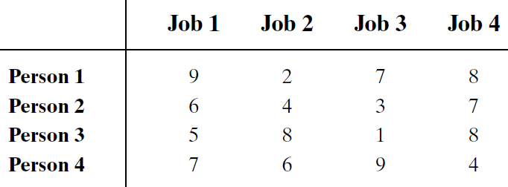
Example

Slide 24
Solution

Slide 25
Time Complexity

Slide 26
Comments on Exhaustive Search
It runs in a realistic amount of time only on very small instances.
In some cases, there are much better alternatives.
In many cases, exhaustive search or its variation is the only known way to get the exact solution.

Slide 27
Puzzle: Finger Counting
Alice counts using the fingers of her left hand as follows.
  She starts by calling her thumb 1, the first finger 2, middle finger 3, ring finger 4, and little finger 5.
  Then she reverses direction, calling the ring finger 6, middle finger 7, the first finger 8, and her thumb 9, after which she calls her first finger 10, and so on.
  If she continues to count in this manner to 1000, on which finger will she stop?

Slide 28
Solution

